Slide 1
Comparison of robust estimator with least square estimator in magnetotelluric impedance estimation
Hang Chen
Department of Geosciences
Boise State University
Notes:
Hi everyone. Today I want to talk about the robust estimator and least square estimator. And apply them in magnetotelluric impedance estimation

Slide 2
Outline
Introduction
Basic Concepts
Synthetic MT data experiments
Results
Summaries
Notes:
Here is the outline. I want to talk about it in five parts.

Slide 3
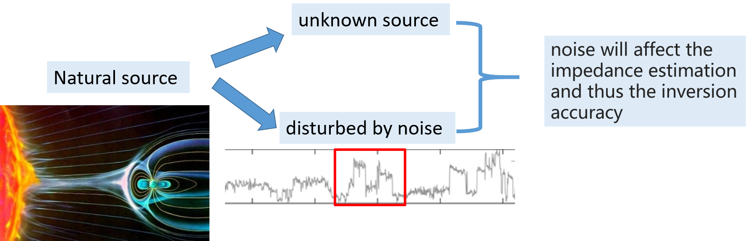
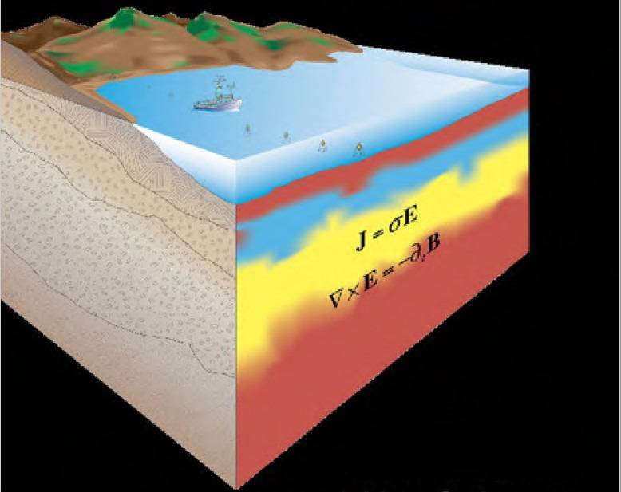
Introduction
Magnetotelluric (MT) is a geophysical exploration method to study the electric structure of the earth by using natural alternating electromagnetic fields (Chave and Jones, 2012).
(Chave and Jones, 2012).
Notes:
First, a brief introduction to the magnetotelluric method or MT. MT is a geophysical exploration method to study the electric structure of the earth by using natural alternating electromagnetic fields. It takes the natural source as the signal and natural source is very weak, therefore, it can be easily affected by noise. Noise will affect the impedance estimation and thus inversion accuracy. So it is very important to have unbiased impedance estimation.

Slide 4
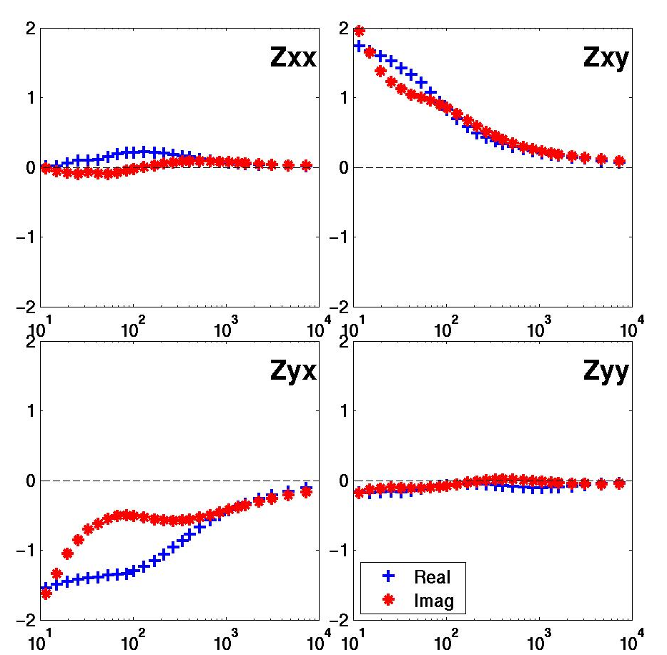
Basic Concepts
MT impedance
B_{z}
B_{x}
B_{y}
E_{x}
E_{y}
(Egbert and Booker,1986)
Notes:
Now I want to introduce some basic concepts about MT impedance estimation. In practice, we estimate the MT impedance from the measured electrical and magnetic signal. Because both electrical and magnetic field have two directions, the impedance is a four-component tensor. Here, Zxx, Zxy, Zyx, Zyy

Slide 5
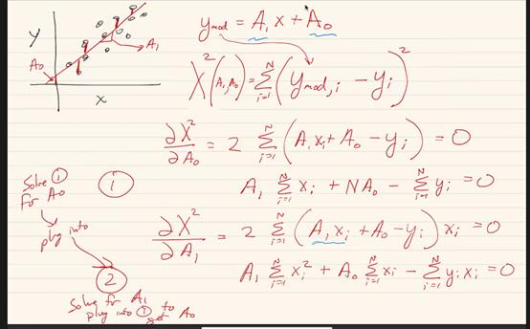
Basic Concepts
Linear regression
Least square method
(From HP’s class)
Notes:
Now, we have the electrical data E and magnetic data B. Let’s take one direction for example, here, the Ex and Bx, By are related by Zxx and Zxy. So what can we recall from this equation. Yeah, right, it is very similar to the linear regression that we have learnt. This handwriting is from HP, I think it can help recall what we have learnt about least square. Here, if we want to fit these data points with a straight line. Then we will do the derivate to the chi square error and enforce it into zeros and we can estimate the parameters. From linear algebra, this process can be simplified as this.

Slide 6
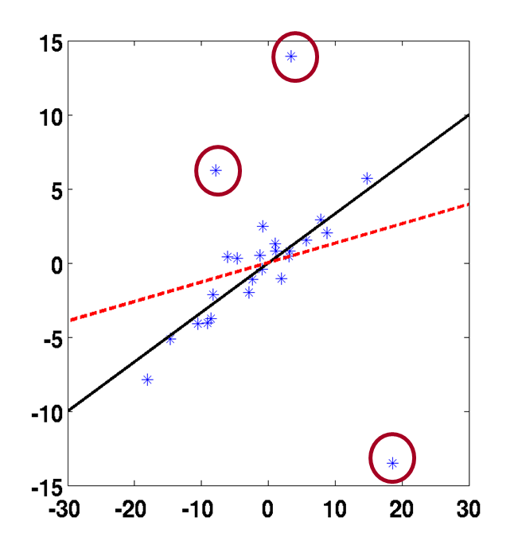
Basic Concepts
Uncertainty
Error covariance (variance)
Least square estimator
Least square estimator
Monte Carlo
R
Sampled 80% data with replacement
Robust estimator
Robust estimator
100 times
（Huber, 2004)
95% uncertainty limit
Notes:
So that’s least square estimator, what about robust estimator. From this figure, we can see that red line is estimated from least square and it is oblivious that least square is easily affected by these outliers. To overcome this problem, robust estimator is proposed to downweight these outliers by this equation. And we can see, this black line, estimated from robust method is fitting the trend better.
After we estimate the parameters, we also want to know the uncertainty for these parameters. Traditionally, in MT impedance estimation, people like to use the error variance to represent the uncertainty. After this course, I’d like to use the Monte Carlo simulation to obtain the uncertainty. I sample 80% data to estimate the impedance with 100 times and use the 95% uncertainty limit like homework 4.

Slide 7
Synthetic MT data experiments
Add noise
Notes:
First, I have the synthetic MT data experiments, I add some synthetic noise to the data and then estimate the impedance to E or B or E and B. Here, I choose three different distributed noise, Gaussian, Cauchy and Levy noise. If we plot the QQ plot to the noise, we can find that Gaussian noise is a straight line and Cauchy and Levy noise have long-tail. So these two noise are very strong.

Slide 8
Results
Least Square
Robust
Add 30% Gaussian noise in electrical field
Notes:
First I add 30% Gaussian noise in electrical field. Because it is synthetic data, we know the true impedance and impedance can be converted into apparent resistivity and phase. So we can see that with Gaussian noise in electrical field , both least square and robust performs well.

Slide 9
Least Square
Robust
Add 30% Cauchy noise in electrical field
Notes:
With more extremely noise in electrical field, , here with Cauchy noise, least square seems have worse results but robust method is still pretty good.

Slide 10
Least Square
Robust
Add 30% Lévy
noise in electrical field
Notes:
When with Levy noise in electrical field, least square is still bad but robust method can almost deal with it

Slide 11
Least Square
Robust
Add 30% Gaussian noise in electrical field
Add 30% Gaussian noise in magnetic field
Notes:
Now we add noise in both electrical and magnetic field. We can see that when Gaussian noise exists in magnetic field, both least square and robust have down-biased results. The phase is still pretty good.

Slide 12
Least Square
Robust
Add 30% Gaussian noise in electrical field
Add 30% Cauchy noise in magnetic field
Notes:
When more extreme noise, Cauchy noise in magnetic field, two methods fail.

Slide 13
Least Square
Robust
Add 30% Gaussian noise in electrical field
Add 30% Lévy
noise in magnetic field
Notes:
Still with Levy noise, the results are much worse

Slide 14
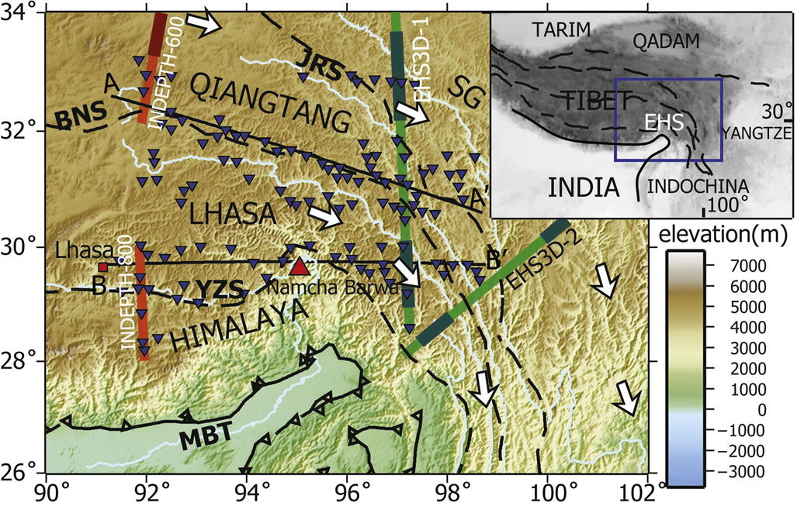
Results
Measured MT data in Tibet plateau
Least Square
Robust
Dong et al, 2016
Notes:
Now I apply this two method in measured MT data collected from Tibet plateau. Here is the result. It seems results from least square is similar to the robust. This data is collected in this place.

Slide 15
Results
Measured MT data in Tibet plateau
Least Square
Robust
Dong et al, 2016
Notes:
Another results from measured data, it is still very similar. Except for sometimes, the uncertainty for least square is larger the that from robust.

Slide 16
Conclusion
The MT impedance estimation problem is similar to the linear regression problem in the statistic. We can use the methods in linear regression problem to estimate the MT impedance.
In synthetic data tests, the results show that with Gaussian noise these two methods perform similarly. With the extreme noise, the robust method is much better than the least square method. However, if some noise exists in the input channel ( i.e. magnetic field), both methods fail. (Note:A remote reference method (Gamble et al, 1979) can reduce the effect of noise in the input channel).
In some measured MT data, these two estimators perform very similarly and robust method is a little better than the least square method. This may be because the measured data are not affected by extreme noise.
Notes:
So now come to the conclusion.

Slide 17
Reference
Chave, A.D. and Jones, A.G. eds., 2012. The magnetotelluric method: Theory and practice. Cambridge University Press.
Egbert, G.D. and Booker, J.R., 1986. Robust estimation of geomagnetic transfer functions. Geophysical Journal International, 87(1), pp.173-194.
Huber, P.J., 2004. Robust statistics (Vol. 523). John Wiley & Sons.
Gamble, T.D., Goubau, W.M. and Clarke, J., 1979. Magnetotellurics with a remote magnetic reference. Geophysics, 44(1), pp.53-68.
Dong, H., Wei, W., Jin, S., Ye, G., Zhang, L., Yin, Y., Xie, C. and Jones, A.G., 2016. Extensional extrusion: Insights into south-eastward expansion of Tibetan Plateau from magnetotelluric array data. Earth and Planetary Science Letters, 454, pp.78-85.

Slide 18
Thank you for listening
Notes:
So thank you for listening. And for questions?

